Slide 1

SAP Cloud Platform Solution Diagrams & Icons Guidelines v08
SAP Cloud Platform Product Management & Operations, Central PM Team
July 5, 2019

Slide 3
Terms of Use for the SAP Cloud Platform Solution Diagrams, Design Elements and Icons (see PDF document)
The SAP Terms of Use found here, along with the terms of use that are specific to the SAP Diagrams, Design Elements, and Icons, below, govern your use of these SAP Materials (as defined in the Terms of Use), and related Content and web pages. Unless otherwise indicated, all capitalized words used below shall have the same meanings given to such words in the SAP Terms of Use.
By attempting to access or use these SAP Materials, You agree that these Terms form a legally binding agreement between You ("You" or "Your") and SAP SE, for and on behalf of itself and its subsidiaries and affiliates (as defined in Section 15 of the German Stock Corporation Act), and You agree to be bound by these terms with respect to your use of the Diagrams and Icons. If You are accessing the SAP Materials on behalf of Your employer in your capacity as an employee, or as a consultant or agent of a third party (this third party in any of these cases being referred to as "Your Company"), You represent and warrant that You have the authority to act on behalf of and bind Your Company to these Terms, and everywhere in this Agreement that refers to 'You' or 'Your' shall also include Your Company. If You do not agree to these terms, do not attempt to access or use the SAP Materials.
You are entitled to (a) access the Diagrams, Design Elements, and Icons, and use these SAP Materials as a reference tool for activities you perform as an individual or as part of your employment, and (b) include these SAP Materials in documents, reports, or other works that you create in direct or indirect support of the deployment or use of SAP products or services (including a third party’s deployment or use of SAP products or services). The above described use is subject to SAP’s policies on the Use of Copyrighted Material found at this page https://www.sap.com/corporate/en/legal/copyright/use-of-copyrighted-material.html including the following conditions set forth in Section II:
The SAP Materials and all copies shall remain at all times the exclusive property of SAP SE and/or an SAP affiliate company.
You must use the SAP Materials without modification (except as may be necessary to resize or otherwise convert the SAP Material to a permitted format).
In the event You use more than an incidental number or terms or definitions in your work, You must include the statement indicating the SAP Materials are “Used with permission of SAP SE” in a prominent location.
You may not use the SAP Material in any offensive manner or context, for example in a way that is defamatory, disparaging or libelous to, or otherwise presents false or misleading information regarding, SAP or any other party, or its or their products or services; in conjunction with obscene or pornographic material; in a manner that suggests bias based on race, national origin, gender, sexual orientation, or religion; or in any manner that would be illegal under applicable law.
You may not imply any SAP sponsorship, affiliation or endorsement.
You may not use the SAP Material for a purpose competitive with SAP or its products unless otherwise clearly permitted by applicable law.
You may not use the SAP corporate logo.
No use of other SAP trademarks is granted under this section. For information regarding use of SAP trademarks, see http://www.sap.com/corporate/en/legal/trademark.html.
You are not permitted to:
Archive or download the Diagrams, Design Elements, and Icons, or archive or download data to create a derivative database or work, other than as expressly permitted herein; or
Use the Web Site or any SAP Materials to provide products or services to anyone outside your organization, except as expressly provided herein or with the prior written authorization of SAP.

Slide 4
SAP Cloud Platform Solution Diagrams & Icons Guidelines Readme
Official SAP design guidelines & icons to create SAP Cloud Platform Solution Diagrams using Microsoft PowerPoint.
Reach a better and faster understanding of SAP Cloud Platform end-to-end solution scenarios as customer, partner, client, solution architect, project lead or developer by using graphical diagrams for visual learning.
Accelerate learning curve for customers & partners with common iconography and solution diagram design following SAP Cloud Platform UX principles (Fiori design).
Use the Microsoft PowerPoint slide deck SAP-Cloud-Platform_official-solution-diagrams-and-icons_v08.pptx available for download on public wiki page SAP Cloud Platform Solution Diagrams & Icons
Find the icons, diagram elements or sample diagrams that you need
Create your own SAP Cloud Platform solution diagram for own purposes including twitter, sap.com blogs, project documentation, interactions with clients, workshops
For more information see public wiki SAP Cloud Platform Solution Diagrams & Icons
Or directly contact Bertram Ganz via email bertram.ganz@sap.com
Yours SAP Cloud Platform PM & Operations, Central PM team

Slide 5
SAP Cloud Platform Solution Diagrams & Icons Guidelines Table of Contents
SAP Icons and Logos
SAP Cloud Platform Capability Icons
SAP Cloud Platform service icons (for Diagrams & Slides)
SAP SaaS application icons
SAP Icons
SAP Logos
Third-Party Logos
Whitelisted Third-Party Logos
Elements for MS PowerPoint Slides
Colors
Areas, Cardinality Markers, Environment Areas
Text in Flex Grey
Text in L0-blue, Emphasis and Semantic Colors
Connectors, Arrows & Lines
Numbers
Design Guidelines
Elements for Protocols, Interfaces and Trust Relationships
Style to Show Inner Part of Application or Service
Arrow Directions
Dos and Don’ts
Tips and Tricks
How to create Colored Icons in 5 Steps
Comparison with SAP Technical Architecture Modeling (TAM) Block Diagrams
Community Support
Solution Diagram Examples
Resources
Version Change History

Slide 6
SAP Cloud Platform Solution Diagrams & Icons SAP Icons and Logos
TOC | SAP Icons and Logos | 3rd Party Logos | Slide Elements | Guidelines | Examples | Resources | Changes

Slide 7
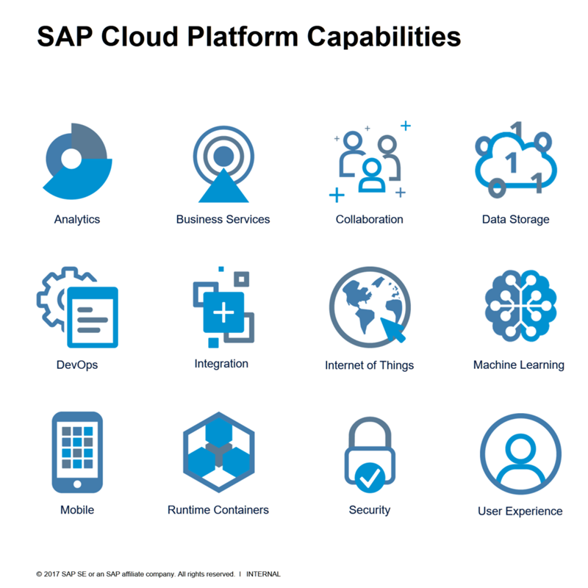
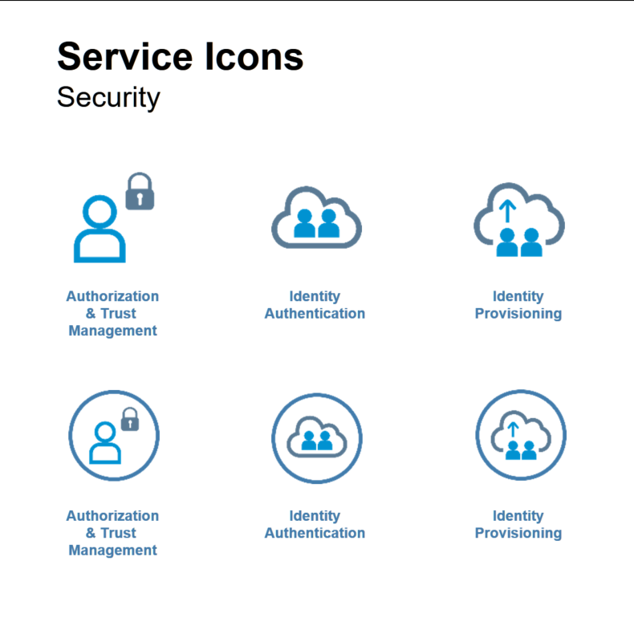
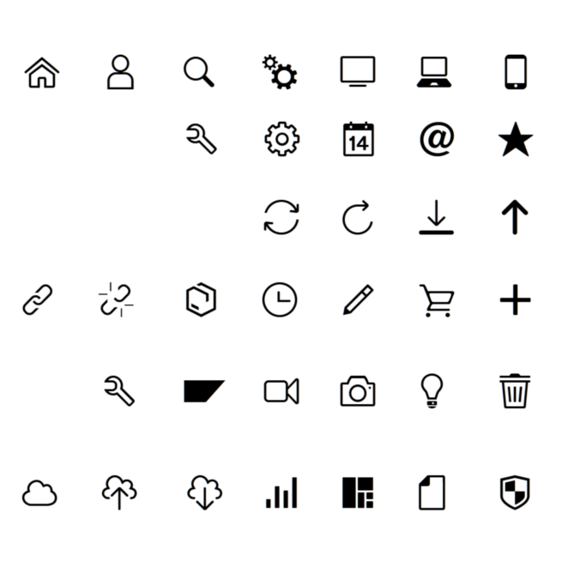
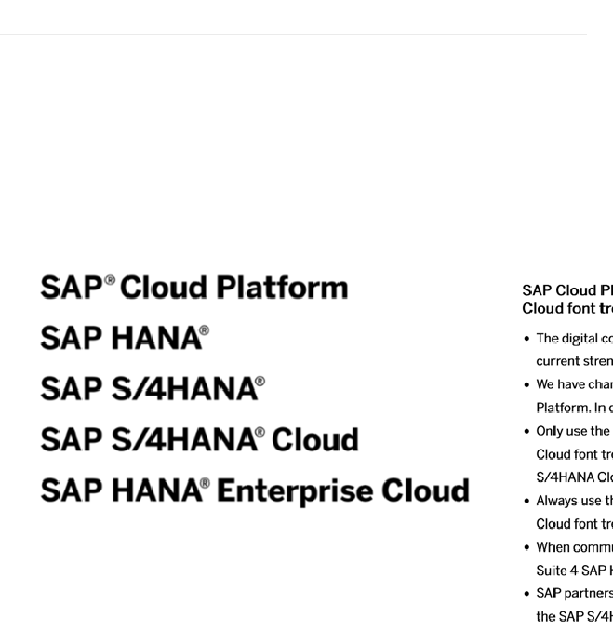
SAP Cloud Platform Solution Diagrams & Icons SAP Icons and Logos
Capability Icons
Service Icons
Other SAP Icons
SAP Logos
SAP Cloud Platform Capabilities, for example, Analytics, Internet of Things, Collaboration
SAP Cloud Platform Service Icons, for example, Connectivity Service, SAP Web IDE for diagrams (with circle) and slides (without circle)
SAP Icons, using the SAP’s own icon fonts like SAP Icon Font or TNT Font
Logos for SAP products, for example SAP Cloud Platform, SAP SuccessFactors

Slide 8























SAP Cloud Platform Solution Diagrams & Icons SAP Cloud Platform Capability Category Icons*
* read more about SAP Cloud Platform Capabilities here … https://cloudplatform.sap.com/capabilities.html
Capability Categories
Other Icons*
*the below icons do not represent SAP Cloud Platform capability categories but are used to depict related topics
Analytics
Blockchain
Collaboration
Commercialization
Data Management
Data Privacy & Security
Developer Experience
Dev / Ops
Document Management
Globalization
Integration
Internet of Things
LoBs & Industries
Machine Learning
Master Data
Mobile
Orchestration
Output Management
Rates & Measures
Runtimes & Containers
User Experience
User Management
Infrastructure

Slide 9



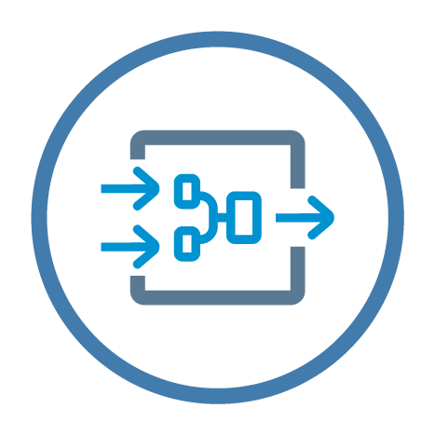




SAP Cloud Platform Solution Diagrams & Icons SAP Cloud Platform Service Icons for Solution Diagrams
Analytics
Artificial Intelligence & Machine Learning
SAP Predictive Service
SAP Analytics Cloud
Smart Business Service
SAP Streaming
Analytics
SAP Leonardo
Machine Learning Foundation
Conversational AI
SAP RealSpend
SAP Web Analytics
* read more about SAP Cloud Platform Services here … SAP Cloud Platform Help: Services

Slide 10




SAP Cloud Platform Solution Diagrams & Icons SAP Cloud Platform Service Icons for Solution Diagrams
Blockchain
MultiChain
Hyperledger Fabric
Blockchain Application Enablement
Quorum

Slide 11




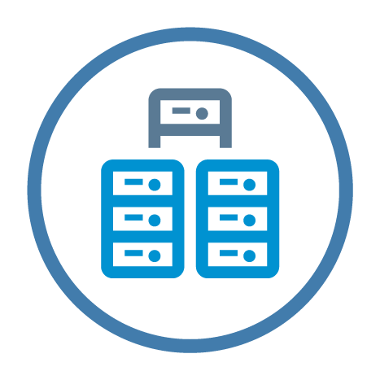








SAP Cloud Platform Solution Diagrams & Icons SAP Cloud Platform Service Icons for Solution Diagrams
Collaboration
Data Management
Feedback Service
Gamification
Intelligent Product Design
SAP Jam
Big Data
Services
MongoDB
Object Store
SAP ASE service
SAP HANA service
PostgreSQL
Redis
SAP HANA spatial services
SAP Data Intelligence
* read more about SAP Cloud Platform Services here … SAP Cloud Platform Help: Services

Slide 12

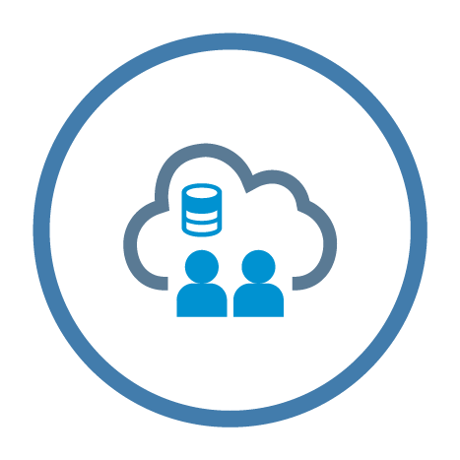












SAP Cloud Platform Solution Diagrams & Icons SAP Cloud Platform Service Icons for Solution Diagrams
Data Privacy & Security
Developer Experience
Authorization and Trust Management
Identity Directory
Platform Identity Provider
Keystore
Corp. Git Link for SAP Web IDE
Git service
Java Debugging
SAP RAD by Mendix
SAP Web IDE
SAP Web IDE Full-Stack
OAuth 2.0 service
SAP Live Link 365 for Authentication
Credential Store
Data Retention Manager
Data Privacy Governance
* read more about SAP Cloud Platform Services here … SAP Cloud Platform Help: Services

Slide 13








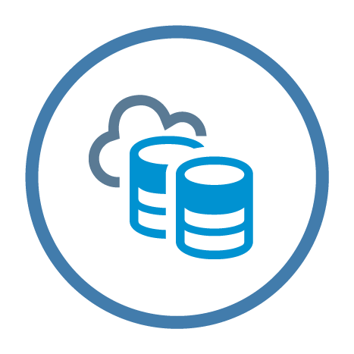






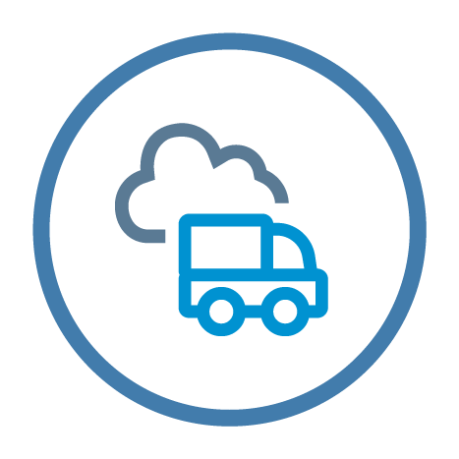
SAP Cloud Platform Solution Diagrams & Icons SAP Cloud Platform Service Icons for Solution Diagrams
DevOps
Agent Activation for Dynatrace
Alert Notification service
Application Autoscaler
Application Logging
Bandwidth
Custom Domains
Enhanced Disaster Recovery
Feature Flags service
High Availability Option
Java Apps Lifecycle Management
Job Scheduler
Monitoring service
Performance Statistics service
Profiling service
Solutions Lifecycle Management
Transport Management
* read more about SAP Cloud Platform Services here … SAP Cloud Platform Help: Services

Slide 14







SAP Cloud Platform Solution Diagrams & Icons SAP Cloud Platform Service Icons for Solution Diagrams
Globalization
Document Management
SAP Localization Hub, tax service
SAP Translation Hub
SAP Localization Hub, advanced compliance reporting service
SAP Document Center
Document service
SAP Localization Hub, candidate pipeline service
SAP Localization Hub, digital compliance service for <country>
* read more about SAP Cloud Platform Services here … SAP Cloud Platform Help: Services

Slide 15

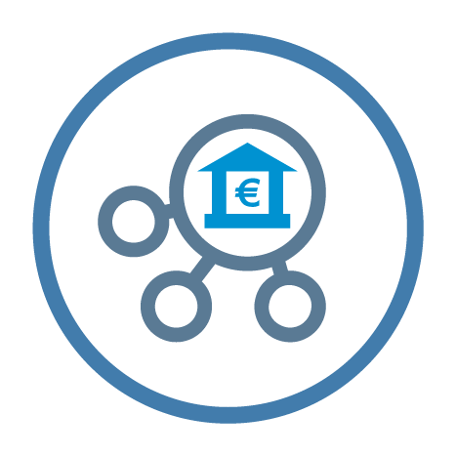



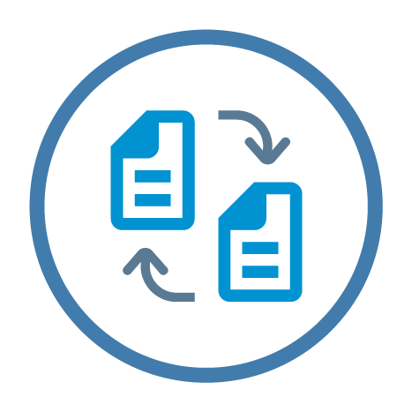

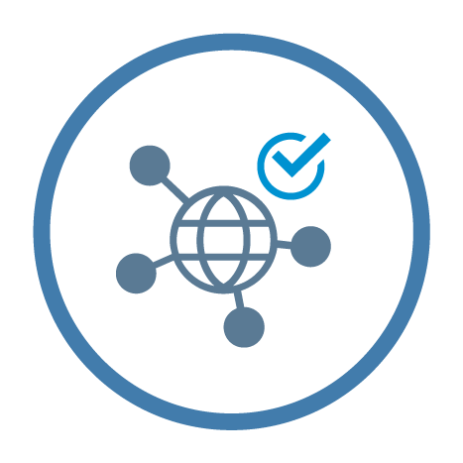









SAP Cloud Platform Solution Diagrams & Icons SAP Cloud Platform Service Icons for Solution Diagrams
Integration
Internet of Things
API Management
SAP API Business Hub
SAP Banking API
SAP Enterprise Messaging
Cloud Integration
Internet
of Things
SAP Remote Data Sync
SAP Asset
Intelligence Network
SAP IoT Application Enablement
Integration Advisor
Connectivity
OData Provisioning
Open Connectors
RabbitMQ
Digital Content Hub
Destination
Backend Service
Smart Data Integration
NOTE: “Smart Data Integration” is part of / depends on “SAP HANA service”
* read more about SAP Cloud Platform Services here … SAP Cloud Platform Help: Services

Slide 16







SAP Cloud Platform Solution Diagrams & Icons SAP Cloud Platform Service Icons for Solution Diagrams
LoBs & Industries
Master Data
SAP Customer Order Sourcing
SAP Omnichannel Promotion Pricing
SAP Data Quality Management, microservices for location data
Master Data for Business Partners
Pricing service
Product configuration service
SAP S/4HANA Cloud for Data Enrichment
NOTES: “Pricing service”, “Product configuration” service and SaaS App “SAP Product Configuration” belong together. “Pricing service” was formerly known as SAP Product Configuration add-on for SAP Hybris Commerce
* read more about SAP Cloud Platform Services here … SAP Cloud Platform Help: Services

Slide 17








SAP Cloud Platform Solution Diagrams & Icons SAP Cloud Platform Service Icons for Solution Diagrams
Mobile
Orchestration
Agentry
Development & Operations
SMS Messaging
Business Rules
Workflow
SAP Intelligent RPA
Deprecated icons (services either removed from catalog** or subsumed by other service***)
App & Device** Management
Fiori Mobile***
*** subsumed in Mobile Service for Development & Operations
* read more about SAP Cloud Platform Services here … SAP Cloud Platform Help: Services

Slide 18



SAP Cloud Platform Solution Diagrams & Icons SAP Cloud Platform Service Icons for Solution Diagrams
Output Management
Rates & Measures
Live Link for IN365 E-Mail
Forms by Adobe
Market Rates Management
* read more about SAP Cloud Platform Services here … SAP Cloud Platform Help: Services

Slide 19








SAP Cloud Platform Solution Diagrams & Icons SAP Cloud Platform Service Icons for Solution Diagrams
Runtimes & Containers
User Experience
Application Runtime
Virtual Machine
Java Server
Functions
Portal
SAP Build
UI Theme Designer
SAP Fiori Cloud
* read more about SAP Cloud Platform Services here … SAP Cloud Platform Help: Services

Slide 20




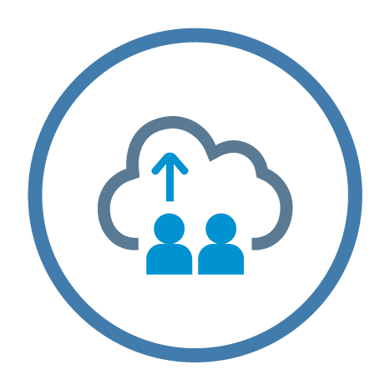

SAP Cloud Platform Solution Diagrams & Icons SAP Cloud Platform Service Icons for Solution Diagrams
User Management
Extras
Identity Authentication
Generic Service Icon
Cloud Connector
SAPUI5 Application
Data Provisioning Agent
Identity Provisioning
* read more about SAP Cloud Platform Services here … SAP Cloud Platform Help: Services

Slide 21




















SAP Cloud Platform Solution Diagrams & Icons SAP SaaS Application Icons
SAP SaaS Applications (at Cloud Foundry Subscription Screen)
SAP Digital Payments add-on
SAP Sourcing Simulation and Optimization for Industries*
SAP Global Track and Trace
Audit Log Management Service
SAP Digital Payments add-on
SAP Sourcing Simulation and Optimization for Industries*
SAP Global Track and Trace
Audit Log Management service
SAP Entitlement Management System
Digital Manufacturing Cloud
SAP Cloud Platform Watch List Screening
SAP Cloud Platform Watch List Screening Hits
SAP Entitlement Management System
Digital Manufacturing Cloud
SAP Cloud Platform Watch List Screening
SAP Cloud Platform Watch List Screening Hits
SAP Predictive Maintenance and Service
SAP Product Configuration
SAP Predictive Maintenance and Service
SAP Product Configuration
* also known as “SAP Supply Base Optimization”

Slide 22





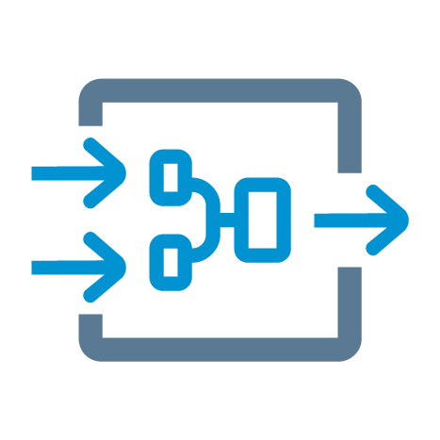


SAP Cloud Platform Solution Diagrams & Icons SAP Cloud Platform Service Icons for Slides
Analytics
Artificial Intelligence & Machine Learning
SAP Predictive Service
SAP Analytics Cloud
Smart Business Service
SAP Leonardo
Machine Learning Foundation
Conversational AI
SAP Streaming
Analytics
SAP RealSpend
SAP Web Analytics
* read more about SAP Cloud Platform Services here … SAP Cloud Platform Help: Services

Slide 23


SAP Cloud Platform Solution Diagrams & Icons SAP Cloud Platform Service Icons for Slides
Blockchain
MultiChain
Hyperledger Fabric
Blockchain Application Enablement
Quorum
* read more about SAP Cloud Platform Services here … SAP Cloud Platform Help: Services

Slide 24



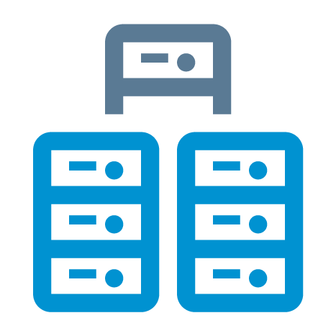






SAP Cloud Platform Solution Diagrams & Icons SAP Cloud Platform Service Icons for Slides
Collaboration
Data Management
SAP Jam
Object Store
SAP ASE service
Feedback Service
Gamification
Intelligent Product Design
Big Data
Services
MongoDB
SAP HANA service
PostgreSQL
Redis
SAP HANA spatial services
SAP Data Intelligence
* read more about SAP Cloud Platform Services here … SAP Cloud Platform Help: Services

Slide 25

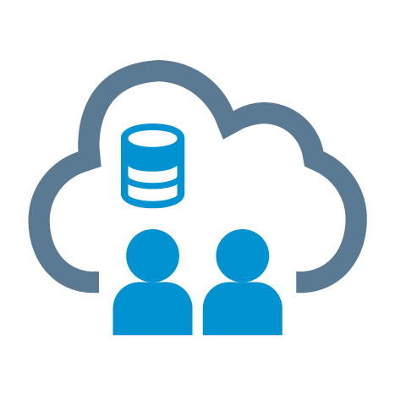









SAP Cloud Platform Solution Diagrams & Icons SAP Cloud Platform Service Icons for Slides
Data Privacy & Security
Developer Experience
Authorization
and Trust
Management
Identity Directory
Platform Identity Provider
Keystore Service
Corp. Git Link for SAP Web IDE
Java Debugging
Git Service
Rapid Application Development by Mendix
SAP Web IDE
OAuth 2.0 Service
SAP Live Link 365 for Authentication
Credential Store
Data Retention Manager
Data Privacy Governance
* read more about SAP Cloud Platform Services here … SAP Cloud Platform Help: Services

Slide 26














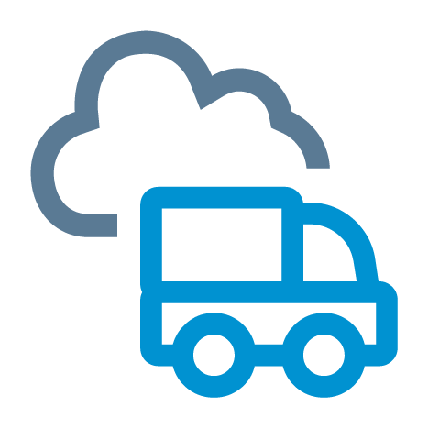
SAP Cloud Platform Solution Diagrams & Icons SAP Cloud Platform Service Icons for Slides
DevOps
Agent Activation for Dynatrace
Alert Notification service
Application Autoscaler
Application Logging
Bandwidth
Custom Domains
Enhanced Disaster Recovery
Feature Flags
High Availability Option
Java Apps Lifecycle Management
Job Scheduler
Monitoring service
Performance Statistics service
Profiling service
Solutions Lifecycle Management
Transport Management
* read more about SAP Cloud Platform Services here … SAP Cloud Platform Help: Services

Slide 27






SAP Cloud Platform Solution Diagrams & Icons SAP Cloud Platform Service Icons for Slides
Globalization
Document Management
SAP Localization Hub, tax service
SAP Translation Hub
SAP Localization Hub, advanced compliance reporting service
SAP Document Center
Document service
SAP Localization Hub, advanced compliance reporting service
SAP Localization Hub, digital compliance service for <country>
* read more about SAP Cloud Platform Services here … SAP Cloud Platform Help: Services

Slide 28





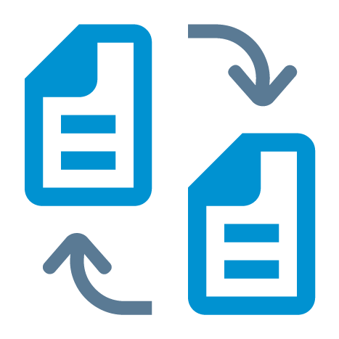










SAP Cloud Platform Solution Diagrams & Icons SAP Cloud Platform Service Icons for Slides
Integration
Internet of Things
API Management
SAP API Business Hub
SAP Banking API
SAP Enterprise Messaging
Cloud Integration
Internet
of Things
SAP Remote Data Sync
Integration Advisor
Connectivity
OData Provisioning
Open Connectors
RabbitMQ
SAP Asset
Intelligence Network
SAP IoT Application Enablement
Digital Content Hub
Destination
Backend service
Smart Data Integration
NOTE: “Smart Data Integration” is part of / depends on “SAP HANA service”
* read more about SAP Cloud Platform Services here … SAP Cloud Platform Help: Services

Slide 29







SAP Cloud Platform Solution Diagrams & Icons SAP Cloud Platform Service Icons for Slides
LoBs & Industries
Master Data
SAP Customer Order Sourcing
SAP Omnichannel Promotion Pricing
SAP Data Quality Management, microservices for location data
Master Data for Business Partners
Pricing service
Product configuration service
SAP S/4HANA Cloud for Data Enrichment
NOTES: “Pricing service”, “Product configuration” service and SaaS App “SAP Product Configuration” belong together. “Pricing service” was formerly known as SAP Product Configuration add-on for SAP Hybris Commerce
* read more about SAP Cloud Platform Services here … SAP Cloud Platform Help: Services

Slide 30






SAP Cloud Platform Solution Diagrams & Icons SAP Cloud Platform Service Icons for Slides
Mobile
Orchestration
Agentry
Development & Operations
SMS Messaging
Fiori Mobile
Business Rules
Workflow
SAP Intelligent RPA
* read more about SAP Cloud Platform Services here … SAP Cloud Platform Help: Services

Slide 31


SAP Cloud Platform Solution Diagrams & Icons SAP Cloud Platform Service Icons for Slides
Output Management
Rates & Measures
Live Link for IN365 E-Mail
Forms by Adobe
Market Rates Management
* read more about SAP Cloud Platform Services here … SAP Cloud Platform Help: Services

Slide 32






SAP Cloud Platform Solution Diagrams & Icons SAP Cloud Platform Service Icons for Slides
Runtimes & Containers
User Experience
Application Runtime
Functions
Java Server
Virtual Machine
Portal
SAP Build
UI Theme Designer
SAP Fiori Cloud
* read more about SAP Cloud Platform Services here … SAP Cloud Platform Help: Services

Slide 33







SAP Cloud Platform Solution Diagrams & Icons SAP Cloud Platform Service Icons for Slides
User Management
Extras
Identity Authentication
Identity Provisioning
Generic Service Icon
Cloud Connector
Data Provisioning Agent
ABAP environment
Application Programming Model
* read more about SAP Cloud Platform Services here … SAP Cloud Platform Help: Services

Slide 34



































SAP Cloud Platform Solution Diagrams & Icons Other SAP Icons (from SAP Icon Font, TNT Font based on SAP Fiori Iconography)
Most used icons:
On-premise
system
system, host
User
Admin
Monitor
Laptop
iPhone
iPad
Application or Package
Database
E-mail
Security
SAPUI5
SAPUI5
Global Account
Subaccount
Locked
Unlocked
Linked
Unlinked
Forward
Cloud Foundry Space
Entitlement
Solution
Upload
Download
Cloud
Wi-Fi
Feed
Public Key
Private Key
Key Pair
Disk
CPU
RAM / Memory
SDK

Slide 35






































































SAP Cloud Platform Solution Diagrams & Icons Other SAP Icons (from SAP Icon Font, TNT Font based on SAP Fiori Iconography)

Slide 36















SAP Cloud Platform Solution Diagrams & Icons SAP Product Logos (white background style)

Slide 37














SAP Cloud Platform Solution Diagrams & Icons SAP Product Logos (black background style)

Slide 38
SAP Cloud Platform Solution Diagrams & Icons Third-Party Logos
TOC | SAP Icons and Logos | 3rd Party Logos | Slide Elements | Guidelines | Examples | Resources | Changes

Slide 39





SAP Cloud Platform Solution Diagrams & Icons Third-Party Logos – Cloud Foundry
Notes:
Image Sources:
https://www.cloudfoundry.org/logo/

Slide 40





SAP Cloud Platform Solution Diagrams & Icons Third-Party Logos – Cloud Foundry (black background)
Notes:
Image Sources:
https://www.cloudfoundry.org/logo/

Slide 41













SAP Cloud Platform Solution Diagrams & Icons Third-Party Logos – Others
Kubernetes Gardener
Notes:
Image Sources:
https://commons.wikimedia.org/wiki/File:Microsoft_Azure_Logo.svg
https://github.com/kubernetes/kubernetes/tree/master/logo
https://github.com/gardener
https://github.com/cncf/artwork/tree/master/cncf
https://cloud.google.com/press/ > Google Cloud Platform Logos

Slide 42









SAP Cloud Platform Solution Diagrams & Icons Third-Party Logos – Others (black background)
Kubernetes Gardener
Notes:
Image Sources:
https://commons.wikimedia.org/wiki/File:Microsoft_Azure_Logo.svg
https://github.com/kubernetes/kubernetes/tree/master/logo
https://github.com/gardener
https://github.com/cncf/artwork/tree/master/cncf
https://cloud.google.com/press/ > Google Cloud Platform Logos
Microsoft Azure > Direct contact (Team Microsoft Azure Business Cloud & Enterprise Group)

Slide 43
SAP Cloud Platform Solution Diagrams & Icons Elements for Microsoft PowerPoint Slides
TOC | SAP Icons and Logos | 3rd Party & Logos | Slide Elements | Guidelines | Examples | Resources | Changes

Slide 44
SAP Cloud Platform Solution Diagrams & Icons: MS PowerPoint Elements Colors (white background style)*
* SAP Cloud Platform Solution Diagrams are based on a selected subset of SAP Fiori Design Colors, see more …
R | G | B | HEX | COLOR | Color Name | Purpose | Fiori Color
66 | 124 | 172 | 427CAC |  | L0-blue | SAP Cloud Platform L0 area and service names | Primary2
0 | 146 | 209 | 0092D1 |  | L1-blue | SAP Cloud Platform L1 area | Secondary6
90 | 122 | 148 | 5A7A94 |  | L2-blue | SAP Cloud Platform L2 area | Primary2 desaturated
127 | 127 | 127 | 7F7F7F |  | Fix grey | SAP Icons, separator lines | not defined
255 or 89 | 255 or 89 | 255 or 89 | #ffffff or #595959 |  | Flex grey / white = SAP Theme Palette Color „Black, Text 1, Lighter 35%“ | Texts, arrows | not defined
26 | 152 | 152 | 1A9898 |  | Emphasize aqua | Emphasize diagram elements | Secondary7
171 | 33 | 142 | AB218E |  | Emphasize purple | Emphasize diagram elements | Secondary4
43 | 125 | 43 | 2B7D2B |  | Semantic green | Emphasize diagram elements | SemanticPositive
187 | 0 | 0 | BB0000 |  | Semantic red | Emphasize diagram elements | SemanticNegative

Slide 45
SAP Cloud Platform Solution Diagrams & Icons: MS PowerPoint Elements Colors (black background style)*
* SAP Cloud Platform Solution Diagrams are based on a selected subset of SAP Fiori Design Colors, see more …
R | G | B | HEX | COLOR | Color Name | Purpose | Fiori Color
66 | 124 | 172 | 427CAC |  | L0-blue | SAP Cloud Platform L0 area and service names | Primary2
0 | 146 | 209 | 0092D1 |  | L1-blue | SAP Cloud Platform L1 area | Secondary6
90 | 122 | 148 | 5A7A94 |  | L2-blue | SAP Cloud Platform L2 area | Primary2 desaturated
127 | 127 | 127 | 7F7F7F |  | Fix grey | SAP Icons, separator lines | not defined
255 or 89 | 255 or 89 | 255 or 89 | #ffffff or #595959 |  | Flex grey / white = SAP Theme Palette Color „Black, Text 1, Lighter 35%“ | Texts, arrows | not defined
26 | 152 | 152 | 1A9898 |  | Emphasize aqua | Emphasize diagram elements | Secondary7
171 | 33 | 142 | AB218E |  | Emphasize purple | Emphasize diagram elements | Secondary4
43 | 125 | 43 | 2B7D2B |  | Semantic green | Emphasize diagram elements | SemanticPositive
187 | 0 | 0 | BB0000 |  | Semantic red | Emphasize diagram elements | SemanticNegative

Slide 46
SAP Cloud Platform Solution Diagrams & Icons: MS PowerPoint Elements Areas (white background style)
SAP Cloud Platform, Area L0
L0-blue RGB(66/124/172)
Non-SAP-Cloud-Platform Area Flex Grey: SAP Theme Palette Color „Black, Text 1, Lighter 35%“
NOTE: automatically becomes white on black background slides
Area L1
L1-blue: RGB(0/146/209)
Area L2, dotted line
L1-blue: RGB(0/146/209)
Primary Emphasize Area aqua
Aqua: RGB(26/152/152)
Emphasize Area aqua, dotted line
Non-SAP-Cloud-Platform Area,
dotted line
Flex Grey: SAP Theme Palette Color „Black, Text 1, Lighter 35%“
Area L2
L2-blue: RGB(90/122/148)
Area L2, dotted line
L2-blue: RGB(90/122/148)
Secondary Emphasize Area purple
Purple: RGB(171/33/142)
Emphasize Area purple, dotted line

Slide 47
SAP Cloud Platform Solution Diagrams & Icons: MS PowerPoint Elements Areas (black background style)
SAP Cloud Platform, Area L0
L0-blue RGB(66/124/172)
Non-SAP-Cloud-Platform Area Flex Grey: SAP Theme Palette Color „Black, Text 1, Lighter 35%“
NOTE: automatically becomes white on black background slides
Area L1
L1-blue: RGB(0/146/209)
Area L2, dotted line
L1-blue: RGB(0/146/209)
Primary Emphasize Area aqua
Aqua: RGB(26/152/152)
Emphasize Area aqua, dotted line
Non-SAP-Cloud-Platform Area,
dotted line
Flex Grey: SAP Theme Palette Color „Black, Text 1, Lighter 35%“
Area L2
L2-blue: RGB(90/122/148)
Area L2, dotted line
L2-blue: RGB(90/122/148)
Secondary Emphasize Area purple
Purple: RGB(171/33/142)
Emphasize Area purple, dotted line

Slide 48
SAP Cloud Platform Solution Diagrams & Icons: MS PowerPoint Elements Environment Boxes
Cloud Foundry Environment
L1-blue: RGB(0/146/209)
Neo Environment
RGB(26/123/246)

Slide 49
SAP Cloud Platform Solution Diagrams & Icons: MS PowerPoint Elements Cardinality Markers
SAP Cloud Platform, Area L0 , L0-blue: RGB(66/124/172)
SAP Cloud Platform, Area L1 L1-blue: RGB(0/146/209)
SAP Cloud Platform Area L2 L2-blue: RGB(90/122/148)
Secondary Emphasize Area purple
purple: RGB(171/133/142)
Primary Emphasize Area aqua aqua: RGB(26/152/152)
Non-SAP-Cloud-Platform Area Flex Grey: SAP Theme Palette Color „Black, Text 1, Lighter 35%“

Slide 50

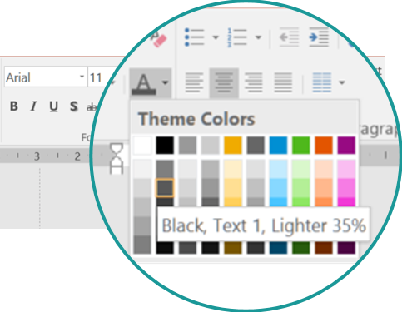
SAP Cloud Platform Solution Diagrams & Icons: MS PowerPoint Elements Text in Flex Grey (Standard Font: Arial*)
* Use standard font Arial instead of BentonSans to avoid rendering issues when sharing slide decks across channels
Copy and paste these text objects
Text in Flex grey*: SAP Theme color “Black, Text 1, lighter 35%”, Arial font
Non-service Icon text
Arial 11 bold / Flex grey: SAP Theme color “Black, Text 1, lighter 35%”)
1
Non-service Icon text
2
Descriptive text element
Arial 11 / Flex grey: SAP Theme color “Black, Text 1, lighter 35%”
Descriptive text
3
L1-L2 area header text
Arial 11 bold / Flex grey: SAP Theme color “Black, Text 1, lighter 35%”
L1-L2 area header
Component title
4
LANDSCAPE AREA TITLE
Arial 14, bold, Flex Grey: SAP Theme color “Black, Text 1, lighter 35%”
*NOTE: Flex grey automatically becomes white on black background slides
LANDSCAPE AREA TITLE

Slide 51

SAP Cloud Platform Solution Diagrams & Icons: MS PowerPoint Elements Text in L0-blue, Emphasis and Semantic Colors (Standard Font: Arial*)
* Use standard font Arial instead of BentonSans to avoid rendering issues when sharing slide decks across channels
Copy and paste these text objects
Service Icon Text
SAP Cloud Platform Service icon text
Arial 11 / L0-blue: RGB(66/124/172)
Service name
subtitle
Text in Emphasize Colors
Text in emphasize aqua: Arial 11 / RGB 26/152/152
Text in emphasize aqua
Text in emphasize purple: Arial 11 / RGB 26/152/152
Text in emphasize purple
Text in Semantic Colors
Text in semantic red: Arial 11 / RGB 187/0/0
Text in semantic red
Text in semantic green: Arial 11/ RGB 43/125/43
Text in semantic green

Slide 52
SAP Cloud Platform Solution Diagrams & Icons: MS PowerPoint Elements Connectors, Arrows and Lines
Flex grey
Emphasize aqua
Emphasize purple
Semantic green
Semantic red
Elbow Connectors
Line Connectors
Arrow Types
Standard: Request-response from client to server (solid line)
Information-flow from data source to target (dashed line)
Bidirectional arrow, for example, a mutual trust relation (solid line)
Landscape Separators
Firewall
Arrow Annotation
Flex grey: SAP Theme color “Black, Text 1, lighter 35%”
annotation text
IMPORTANT: color in Fix grey RGB(127/127/127), but not in Flex grey to keep same on black background style!

Slide 53
SAP Cloud Platform Solution Diagrams & Icons: MS PowerPoint Elements Numbers
Numbers L2-blue: RGB (66/124/172)
1
2
3
4
5
6
7
8
9
10

Slide 54
SAP Cloud Platform Solution Diagrams & Icons Design Guidelines
TOC | SAP Icons and Logos | 3rd Party Logos | Slide Elements | Guidelines | Examples | Resources | Changes

Slide 55


SAP Cloud Platform Solution Diagrams & Icons – Design Guidelines Arrow Directions in SAP Cloud Platform Solution Diagrams
Request-Response Channel: Solid arrow from client (triggering agent) to server (point-to-point connectivity scenario, simplified)
Data Flow Channel: Dashed arrow from source (triggering agent) to target database (data replication scenario, simplified)
Application request arrow with solid line
SAP Cloud Platform HANA database as a service
Data flow arrow with dashed line
Service request
System
On-premise database (source)
HTTPS
SAP Gateway
Data Replication Tool
Database
OData
TCP
ODBC
SAPUI5 application
Connectivity service
Cloud Connector
Protocol
Exposed OData service interface
Connectivity service
Cloud Connector
Protocol
ODBC interface needed for replication process
Mutual Trust Relation: Solid arrow in both directions
Bidirectional RFC: Solid arrow in both directions ( point-to-point connectivity scenario with Cloud Connector 2.10)
Mutual trust relation
Backend system
Protocol
NEO Environment
RFC
SAP S/4HANA Cloud system
mutual trust
Cloud Connector
Bidirectional RFC via tunnel connection
SAP Cloud Identity (Identity Provider)
Notes:
Agents perform operations; they read and write data and communicate with other agents. (Question: Who does something?)
Storages are passive; they only hold data that is accessed by agents. The arrows indicate direction of data flow. (Q: Where is the data?)
Channels are used by agents to communicate with each other. Arrows indicate the direction of data flow, the “R” indicates who initiates the request and then waits for the response. (Q: Which agents communicate? What data and which requests do they exchange?)
Block diagrams show a snapshot view of a system on instance level; to indicate multiple agents or storages, use three dots or stack the nodes.

Slide 56


SAP Cloud Platform Solution Diagrams & Icons: Design Guidelines Graphical Elements to depict Application Protocols, Interfaces and Trust Relationships
Application Protocol
Sample 1
Sample 2
Application protocol
HTTP
Cloud Connector
Application Server ABAP
Application client
SAPUI5 Application
RFC
RFM/BAPI
< protocol name >
Application protocol
Application interface
Application Interface
Sample 1
Application interface
Sample 2
OData/Rest
Java Application
Application interface
SAP Cloud Applications
<interface name>
Application component
SAP Cloud Platform SDK for service development
Custom Code
Java API
OData
Trust Relationship
Sample
SAP Cloud Applications
trust
trust
Mutual trust relationship

Slide 57

SAP Cloud Platform Solution Diagrams & Icons – Design Guidelines Graphical Style to Show the Inner Part of an Application or Service
GUIDELINE: Place the service icon (or the icon that represents another technical component, for example, application) at the edge of a new rectangle that contains inner parts of the service. Fill the service icon with the color white (or the slide background color) to hide the edge line of the rectangle underneath. Place inner parts of the service inside the rectangle.
Sample 1
Service icon (filled white) is placed at the upper edge of the blue rectangle
Sample 3
Inner resource, here a Scale application
Application icon (filled white) is placed at the upper edge of the grey rectangle for “Application Client”
Blue rectangle wraps resources inside the service
Application Client
SAP API Business Hub
End User
Weather Report App Scala.js
SuccessFactors Recruiting APIs
OData
Inner resource, here an OData API representation
Gray rectangle wraps resource, here Scala.js app) inside the app client
Sample 2
Service icon (filled white) is placed at the upper edge of the blue rectangle
Blue rectangle wraps functions inside the service
Sample 4
Client-Side Application Staticfile CF buildpack
SAP Analytics Cloud
SAP HANA Database
Modeling
Predictive
Application icon (filled white) is placed at the upper edge of the grey rectangle for “Client-side Application”
Live connection
GeoServer Erlang
Text & Search
Spatial

Slide 58
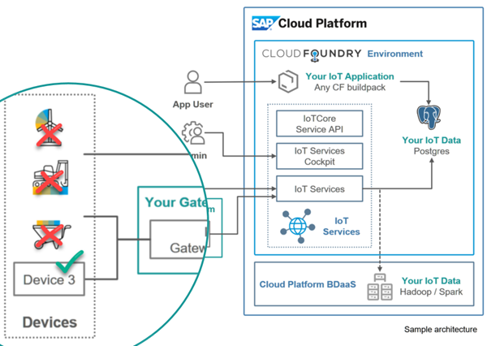
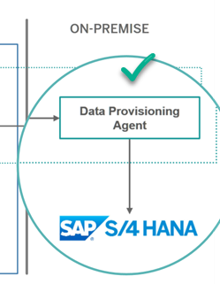
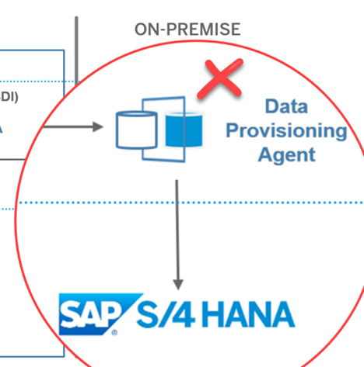
SAP Cloud Platform Solution Diagrams & Icons – Design Guidelines Dos and Don’ts (1)
Don’t mix up different icon designs. For example, don’t use SAP banded-color icons with SAP Cloud Platform solution icons in the same diagram.
Don’t create own new icons, use simple text boxes instead. Request new icons in the SAP Cloud Platform User Community

Slide 59
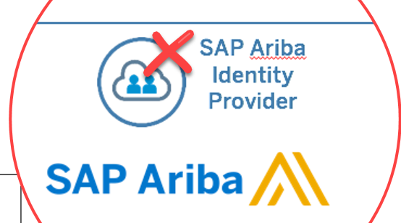
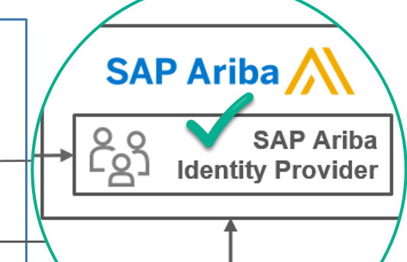
SAP Cloud Platform Solution Diagrams & Icons – Design Guidelines Author Guidelines: Dos and Don’ts (2)
Don’t reuse SAP Cloud Platform service icons outside the SAP Cloud Platform environment; use text boxes instead.

Slide 60
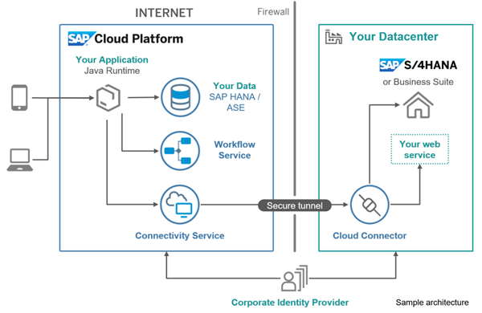
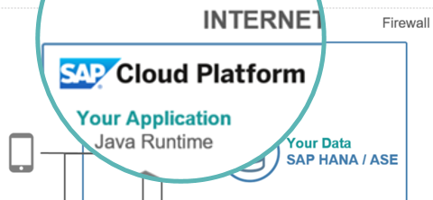
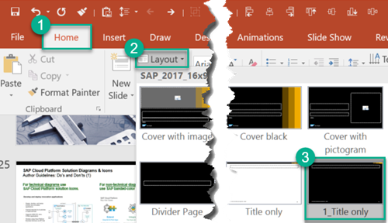
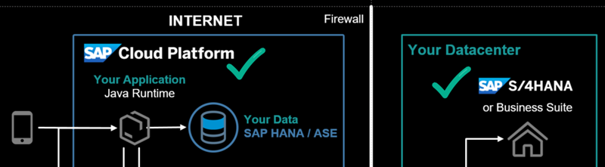
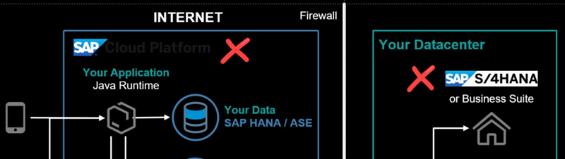
SAP Cloud Platform Solution Diagrams & Icons – Design Guidelines Dos and Don’ts (4)
Use emphasis colors to visually highlight important parts of the solution diagram.
Replace logo images when you switch to a black background style*.
* [On Windows] Select slide layout with shortcut ALT+H and L
3
1
2
4
5

Slide 61
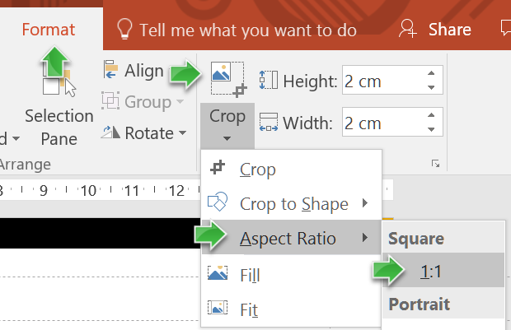
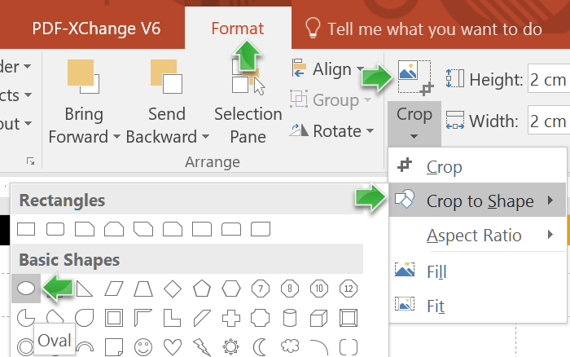
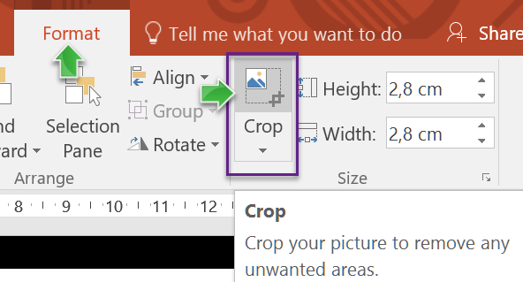
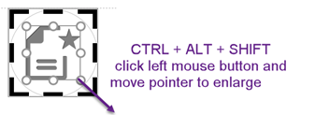
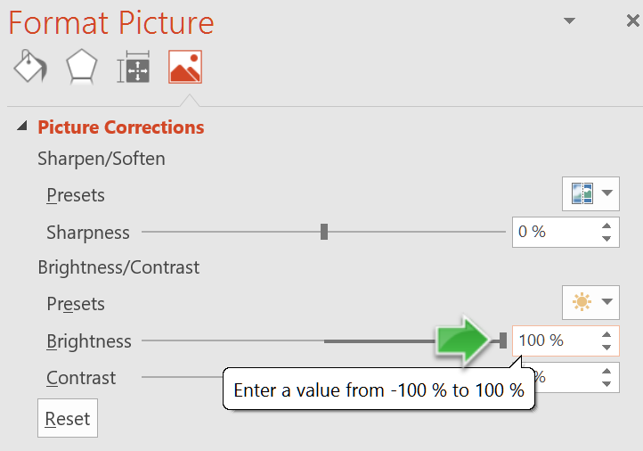

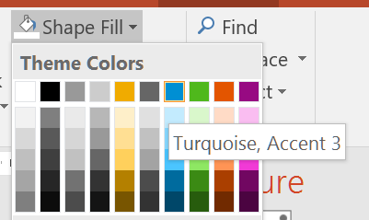
SAP Cloud Platform Solution Diagrams & Icons – Design Guidelines How to Create Colored Icons in Five Steps Solution Diagram example with colored icons: see slide SAP Cloud Platform Solution Diagram Examples > Principal Propagation
1
Set aspect ratio to 1:1
2
Crop to shape “circle”
3
Enlarge crop area
start with grey icon
5
Set 100% brightness
4
Fill shape with color
end with colored icon

Slide 62
SAP Cloud Platform Solution Diagrams & Icons – Design Guidelines Tips and Tricks for using Microsoft PowerPoint (1)
[On Windows] Use little-known keyboard shortcuts for fast editing
MUST USE THIS! Copy and paste one or many shapes/texts/objects to one or many selected (or highlighted) other ones using CTRL+SHIFT+C and CTRL+SHIFT+V.
Duplicate an object using CTRL+D or CTRL+SHIFT+Left Mouse Button.
Center text using CTRL+E. Left or right align using CTRL+L or CTRL+R.
Clear all formatting using CTRL+Spacebar.
Group objects using CTRL+G. Ungroup using CTRL+SHIFT+G.
[On Mac] Use little-known keyboard shortcuts for fast editing
MUST USE THIS! Copy and paste one or many shapes/texts/objects to one or many selected (or highlighted) other ones using CMD(⌘)+SHIFT+C and CMD(⌘)+SHIFT+V.
Duplicate an object using ⌘+D.
Center text using ⌘+E. Left or right align using ⌘+L or ⌘+R.
Clear all formatting using ⌘+Spacebar.
Group objects using ⌘ +ALT+G. Ungroup using ⌘ +ALT+SHIFT+G.

Slide 63

SAP Cloud Platform Solution Diagrams & Icons – Design Guidelines Comparison with SAP TAM Block Diagrams (1)
SAP TAM Block Diagrams |  | SAP Cloud Platform Solution Diagrams
Purpose: Most important diagram type for describing architecture. Show the static structure of the system, and provide a big picture view. |  | Purpose: Domain-specific diagram type that describe SAP Cloud Platform solution scenarios across IT landscapes. Show SAP Cloud Platform services, environments, systems, and their interdependencies.
Agents process information, communicate via channels, access storage |  | Agents, systems, SAP Cloud Platform services depicted as blue circled icons, gray icons, or colored boxes
Storage elements contain information accessed by agents. |  | Storage visualized either as corresponding SAP Cloud Platform database as a service icon or as rounded box for non-SAP-Cloud-Platform storages (for example, an on-premise database).
Channels transport information between agents Request-response channels show the direction of a request, indicating the triggering agent (=the Client) Modifying Access: “A” can read and write storage content Read-only Access: “A” can only read storage content |  | Arrows express “interdependencies” between services, components, users, or systems. Interdependencies include request/response channels, usage relations, data flows (for example, data replication, using a dashed line), or trust relations. The standard interdependency is a request/response channel that points from client to server (using a solid line arrow). For mutual relations like a mutual trust relation from one system to another, a bidirectional, solid line arrow is used. There is no visual difference between modifying and read-only access types; use text annotation to provide additional details that are not represented visually (for example, a modifying read and write access), or use TAM block diagrams instead. See the previous slide for more details on arrow directions.
Notes: Use class diagrams to show how data is located in storages or exchanged via channels. Use activity or sequence or state diagrams to express the behavior of agents and how they interact. |  | Notes: Use SAP TAM Diagrams for more technically detailed SAP Cloud Platform solution architectures.
Agent
SAP Cloud Platform service
User Persona
Agent
Storage
Storage
SAP HANA Database
A1
A2
Client
R
Server
A
S
A
S

Slide 64
SAP Cloud Platform Solution Diagrams & Icons – Design Guidelines Comparison with SAP TAM Block Diagrams (2)
SAP TAM Block Diagram Example
SAP Cloud Platform Solution Diagram Example
Customers
Customers
...
...
Register Edit Profile Browse Orders
Search Get Prod. Info Select Items
Place Order Cancel Order
Register Edit Profile Browse Orders
Search Get Prod. Info Select Items
Place Order Cancel Order
R
R
R
Service Provider
Online Shop: SAPUI5 Applications
Online Shop Server
Service Provider
Customer Account Maintenance
Product Presentation + Selection
Order Processing
Credit Card Institutions
Customer Account Maintenance
Product Presentation + Selection
Order Processing
R
Credit Card Institutions
Shipping
Shipping
Customer’s product selection
Customer’s product selection
SAP HANA Database
REST
...
...
Credit Card Institutions
Suppliers
Connectivity
ERP data
...
SAP S/4HANA on-premise
Firewall
Customer data
Product Information
Product Availability
Orders
Shop Data
OData
Cloud
Connector

Slide 65
SAP Cloud Platform Solution Diagrams & Icons Solution Diagram Examples
TOC | SAP Icons and Logos | 3rd Party Logos | Slide Elements | Guidelines | Examples | Resources | Changes

Slide 66

SAP Cloud Platform Solution Diagram Examples SAP Fiori Cloud
Diagram source: SAP Cloud Platform Blueprints > Modernizing the Employee User Experience with SAP Fiori Cloud
INTERNET
Firewall
End User
Your Datacenter
Consumer subaccount (customer)
or Business Suite
Design time environments
OData Provisioning*
SAP Gateway*
Application Client
Fiori Configuration Cockpit (FCC)
UI theme designer
SAP Web IDE
SAP Build
iOS
subscribed Fiori Cloud apps and content
option 1
option 2
Secure tunnel
Android
Portal
SAP Fiori launchpad
Connectivity service
Cloud connector
Windows
Provider account (SAP)
trust
SAP Fiori Cloud applications & content packages
Identity Authentication tenant
Desktop
* OData services via SAP Cloud Platform OData provisioning or SAP Gateway (see details about deployment options in SAP Enterprise Architecture Explorer (#11115) and in SAP Note 1830712)
Notes:
Enable modern and intuitive user experience for SAP users
Quickly deploy packaged content for SAP S/4HANA and Business Suite
Design, develop, extend and mobilize SAP Fiori apps in the cloud
Extend apps using SAP Web IDE Fiori extension model
Connect securely via internal or external access point
Operations and updates by SAP

Slide 67


SAP Cloud Platform Solution Diagram Examples Extend SAP cloud applications
SAP Cloud Applications
Mobile services
Your Application Java or SAPUI5
OData
Connectivity
Custom Data SAP HANA instance
Corporate Identity Provider

Slide 68
SAP Cloud Platform Solution Diagram Examples Extend SAP cloud applications including SAP S/4HANA Cloud Explore SAP S/4HANA Cloud Extensibility options by leveraging the sample scenarios from SAP: http://sap.com/extends4
SAP Cloud Applications
Your Application ABAP, Java or node.js and SAPUI5
OData
Application Clients
Connectivity
Custom Data SAP HANA instance
Corporate Identity Provider

Slide 69
SAP Cloud Platform Solution Diagram Examples Extend SAP SuccessFactors applications Browse Use Cases on cloudplatform.sap.com: Use Case Finder > SAP SuccessFactors
SAP Cloud Applications
Mobile services
trust
Your Application Java or SAPUI5
OData
Portal
Connectivity
Your Datacenter
Custom Data SAP HANA instance
Corporate Identity Provider

Slide 70
SAP Cloud Platform Solution Diagram Examples Extend SAP SuccessFactors applications Browse Use Cases on cloudplatform.sap.com: Use Case Finder > SAP SuccessFactors
Application Client
SAP Cloud Applications
Subaccount
Your Application Java or SAPUI5
Mobile
Mobile services
End User
Desktop
OData
Portal
Custom Data SAP HANA instance
Connectivity
Your Datacenter
trust
Identity Authentication tenant
Corporate Identity Provider

Slide 71
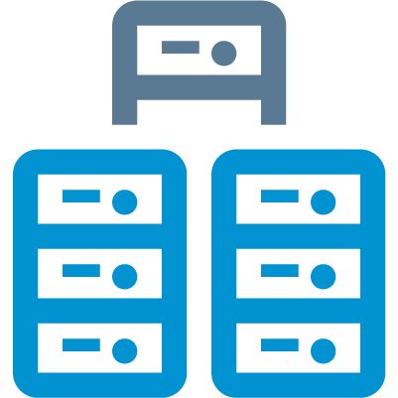
SAP Cloud Platform Solution Diagram Examples SAP Leonardo IoT Foundation and Edge
INTERNET
Your IoT application
Hardware Gateway
SAP Web IDE
Portal SAP Fiori Launchpad
SAP Leonardo IoT
SAP and non- SAP Applications
SAP Leonardo IoT Edge
Cloud Foundry Environment
SAP Edge Services
SAP Leonardo IoT Foundation
SAP Cloud Platform Internet of Things (Core)
SAP IoT Application Enablement
run on
Data Ingestion Pipeline
Sensor embedded things
IoT Gateway Edge*
SAP Cloud Platform Integration
and more …
Your IoT Data Swift I Cassandra** I SAP HANA
*Belongs to SAP Cloud Platform Internet of Things
**Support of SAP Vora planned.

Slide 72
SAP Cloud Platform Solution Diagram Examples Analytical Application based on SAP HANA database Browse Use Cases on cloudplatform.sap.com: https://cloudplatform.sap.com/scenarios/usecases/analytics-cloud.html
INTERNET
Firewall
SAP Cloud Applications
Your Datacenter
Your Services
Applications
Your Application
runs on
Smart Business Service
Portal
On-premise
system
SAP HANA Database
Modeling
Predictive
Live connection
Secure tunnel
Text & Search
Spatial
Connectivity
Cloud Connector
SAP Analytics Cloud
Corporate Identity Provider

Slide 73
SAP Cloud Platform Solution Diagram Examples Develop and deploy innovation applications (white background style)
INTERNET
Firewall
Your Datacenter
Your Application Java Runtime
or Business Suite
Your Data SAP HANA / ASE
Workflow
Your web service
Secure tunnel
Connectivity
Cloud Connector
Corporate Identity Provider

Slide 74
SAP Cloud Platform Solution Diagram Examples Develop and deploy innovation applications (black background style)
INTERNET
Firewall
Your Datacenter
Your Application Java Runtime
or Business Suite
Your Data SAP HANA / ASE
Workflow
Your web service
Secure tunnel
Connectivity
Cloud Connector
Corporate Identity Provider

Slide 75
SAP Cloud Platform Solution Diagram Examples Leverage Cloud Foundry to create innovative applications
INTERNET
Firewall
Your Datacenter
Your Application any buildpack
Your Service 1 using SAP HANA / ASE
or Business Suite
Your Service 2 using Redis
Your Service 3 using MongoDB
Secure tunnel
Connectivity Service
Cloud Connector
¹ Open source CF buildpacks are community supported ² Beta component
Corporate Identity Provider

Slide 76
SAP Cloud Platform Solution Diagram Examples DevOps in SAP Cloud Platform
INTERNET
commit
SAP Web IDE
Git Service
CI Server (for example Jenkins)
Artifact Repository
Eclipse IDE
Your Application
Virtual Machine
deploy

Slide 77
SAP Cloud Platform Solution Diagram Examples SAP Cloud Platform API Management Browse Use Cases on cloudplatform.sap.com: https://cloudplatform.sap.com/scenarios/usecases/monetize-apis.html
INTERNET
Firewall
ON-PREMISE
User network
Your Digital Applications
Your Microservices
or Business Suite
External Developer
SAP Gateway
Partner
API Management
Secure tunnel
Internal Developer
Connectivity
Cloud Connector
Your Datacenter
3rd Party Cloud APIs
Corporate Identity Provider
Your Applications

Slide 78
SAP Cloud Platform Solution Diagram Examples Gaining Consumer Insights: Reference Architecture Overview
USER NETWORK
INTERNET
ON-PREMISE
SAP HANA service
Data Provisioning Agent
End user
Mobile client
mobile service
for development and operations
1
User provides credentials
Smart Data Integration
trust
Redirect the request for authentication
2
SAP Cloud Platform Identity Authentication Service
3
4
Perform authentication
Redirect to the mobile app

Slide 79

SAP Cloud Platform Solution Diagram Examples SAP Cloud Connector 2.10: What’s new in it?
ON-PREMISE LANDSCAPE
INTERNET
Firewall
Region host
SAP Cloud Platform subaccount
HTTPS
Cloud Connector admin user
admin connection
On-premise systems
Cloud Connector
Bidirectional RFC via tunnel connection
SAP S/4HANA
Cloud system
SAP S/4HANA Cloud tenant
RFC
Key User
HTTPS
tunnel

Slide 80





SAP Cloud Platform Solution Diagram Examples SAP‘s modular IoT platform in cloud
SAP Leonardo for IoT
SAP Leonardo for IoT Bridge*
Dashboard | Collaboration
SAP Leonardo IoT Edge
Local data processing
Micro services
Business essential functions
SAP Leonardo for IoT Foundation
SAP and non-SAP Business Applications
Technical Services
Device management
Connectivity
Messaging
Data Management
Aggregate store
Times series store
Data archive
Business Services
Thing modeler
IoT app development
Re-use UI and APIs
and more …
Sensor embedded things
Integration I Analytics I Machine Learning I Security I Orchestration and more
*Future scope

Slide 81
SAP Cloud Platform Solution Diagram Examples Typical S/4HANA Extension Patterns: Hub applications
INTERNET
ON-PREMISE ENTERPRISE NETWORK
Firewall
SAP S/4HANA on-premise
End user
HTTPS
OData service
SAP Gateway
Hub Application in Java
Connectivity service
Cloud Connector
HTTPS
Application Server ABAP
RFC
HTTPS tunnel
RFC
RFM/BAPI
Application Client
TCP
ODBC
Data Replication Tool
Replicate on-premise database to cloud database
Database
SAP Cloud Platform service
Cloud database

Slide 82





SAP Cloud Platform Solution Diagram Examples Principal Propagation
Note: For practical details see Author Guidelines: How to create Colored Icons in 5 Steps
INTERNET
Firewall
ON-PREMISE CORPORATE NETWORK
Client
Secure tunnel
5
Operating System (OS)
Company root CA
: John Doe
: John Doe
Cloud Connector
SAP Gateway
Private root CA
Cloud Connector system
Server SSL standard
Cloud Connector UI
Private root CA
1
: John Doe
Cloud Connector local CA
6
Operating System (OS)
: John Doe
Company Root CA
: John Doe
SAP Web IDE
SAP Backend
2
4
Private Root CA
: John Doe
Identity Authentication service
Application
LEGEND
Certificate signed by the Cloud Connector local CA*
Certificate
Identity from the Identity Provider
Certificate signed by the
private root CA*
Root certificate
Identity from the SAP system
3rd party Identity Provider
3
: John Doe
Intermediate or
CA* certificate
Certificate signed by the
company root CA*
Short-lived certificate
*CA: certificate authority

Slide 83
SAP Cloud Platform Solution Diagram Examples Weather Demo: Developed Using the "Bring Your Own Language" Concept Browse Code Sample on GitHub: https://github.com/SAP/cloud-cf-byol-weather-sample
INTERNET
Cloud Foundry Environment
deploy
App Developer
Client-side Application Staticfile CF buildpack
Server-side Application Community CF buildpack
Application Client
Weather Report App Scala.js
send on startup
HTTPS
GeoNames.org
geographical database
End User
Weather Report App Scala.js
GeoServer Erlang
OpenWeatherMap.org
OpenStreetMap.org

Slide 84
SAP Cloud Platform Solution Diagram Examples Achieve Budget and spend Visibility by Extending SAP S/4HANA Cloud Browse Use Cases on cloudplatform.sap.com: https://cloudplatform.sap.com/scenarios/usecases/extend-s4cloud.html
INTERNET
Subaccount in Cloud Foundry environment
Connectivity
HTTP
OData API
HTTP
HTTP
SAPUI5 App
OData/Rest
OData API
Application Clients
Java Application
SAP Cloud Platform SDK for service development
Custom Code
S/4HANA Cloud SDK
Java API
Java API
trust
SAP ASE service
trust
Corporate Identity Provider

Slide 85
SAP Cloud Platform Solution Diagram Examples Recruitment Travel and Expense Management Dashboard Browse Use Cases on cloudplatform.sap.com: https://cloudplatform.sap.com/scenarios/usecases/travel-expense.html
SAP Cloud Applications
Manager
Subaccount in Cloud Foundry environment
SAP API Business Hub
SuccessFactors Recruiting APIs
Microservices
OpenAPI
OData
OData
REST
Application client
SAPUI5 application
Concur Expense APIs
OData
OData

Slide 86
SAP Cloud Platform Solution Diagram Examples Developing Resilient Microservices on SAP Cloud Platform using Open Source Components Browse Use Cases on cloudplatform.sap.com: https://cloudplatform.sap.com/scenarios/usecases/open-source.html
Description
The overall application is broken down into carefully chosen microservices, which use the Unit Isolation pattern.
The Shed Load pattern at the entry of the microservice
Retry, Timeout pattern when accessing a database service. Circuit breaker pattern for accessing remote services.
Bounded Queue pattern for processing incoming requests and placing them into a job queue for asynchronous processing of client requests, and providing rate limiting on requests that can be processed.
Cloud Foundry Environment
1
Cloud Foundry App with resilient Microservices
1
Java Spring Boot – Business service application
2
Controller logic
2
Destination
End user
3
3
Service logic
Java API
Netflix Hystrix Library
HTTP
Remote Service
Node.js – App Router
read
HTTP
Routing logic
4
write
RabbitMQ
PostgreSQL
Application Client
Java Spring Boot – Worker application
read
4
Worker logic
write

Slide 87










SAP Cloud Platform Solution Diagram Examples SAP Cloud Platform Workflow – the bigger picture
Portal with SAP Fiori Launchpad
SAP Web IDE
deploy
UI Generation
Workflow Samples
Custom UI Applications
My Inbox
Monitor Workflows
deploy
Forms Editor
Workflow Editor
OData
REST / OData
REST / OData
REST / OData
consume
REST
REST
OData Provisioning
Other Services / Applications
SAP Jam
Workflow
Cloud Integration
Business Rules
SAP API Business Hub
ODC
HTTP / RFC / SOAP
REST / OData
HTTP / IDOC / SOAP / OData
Secure Network Channel
SAP Cloud Applications
On-premise IT Landscape
SAP Back-End Systems + 3rd Party
Cloud Connector

Slide 88
SAP Cloud Platform Solution Diagrams & Icons Resources
TOC | SAP Icons and Logos | 3rd Party Logos | Slide Elements | Guidelines | Examples | Resources | Changes

Slide 89
SAP Cloud Platform Solution Diagrams & Icons Resources
SAP Cloud Platform Solution Diagrams & Icons wiki
Be Visual! Use Official Icons and Samples for SAP Cloud Platform Solution Diagrams sap.com community blog, January 5th 2018
SAP Cloud Platform Capabilities and Services: https://cloudplatform.sap.com/capabilities.html
SAP Cloud Platform Help on Services and Capabilities
SAP Cloud Platform Blueprints (as part of scenario use cases) containing solution diagrams https://cloudplatform.sap.com/scenarios.html
SAP Cloud Platform Use Case Finder: https://cloudplatform.sap.com/scenarios/usecases.html (filter use cases by Line of Business, Products, Capabilities and Scenarios)

Slide 90
SAP Cloud Platform Solution Diagrams & Icons Version Changes NOTE: For changes in previous versions see wiki.scn.sap.com page SAP Cloud Platform Solution Diagrams & Icons
TOC | SAP Icons and Logos | 3rd Party Logos | Slide Elements | Guidelines | Examples | Resources | Changes

Slide 91
What's New in Official SAP Cloud Platform Solution Diagrams & Icons Guidelines v08 from July 5, 2019 For changes in previous versions see wiki.scn.sap.com page SAP Cloud Platform Solution Diagrams & Icons
ICONS
New icon category: added „SaaS Applications (at Cloud Foundry subscription screen)
New service icons: Data Management: SAP Data Intelligence / Data Privacy & Security: Data Retention Manager, Data Privacy Governance / Globalization: SAP Localization Hub, advanced compliance reporting service; SAP Localization Hub, candidate pipeline service; SAP Localization Hub, digital compliance service for <country> / Integration: Smart Data Integration / LoBs & Industries: SAP Customer Order Sourcing, SAP Omnichannel Promotion Pricing / Master Data: Master Data for Business Partners, Product configuration service, Pricing service, SAP S/4HANA Cloud for Data Enrichment / Orchestration: SAP Intelligent Robotic Process Automation (RPA)
New SaaS application icons: “SAP Cloud Platform Watch List Screening” and “Screening Hits”, Audit Log Management service, Digital Manufacturing Cloud, SAP Predictive Maintenance and Service, SAP Global Track and Trace, SAP Entitlement Management System, SAP Product Configuration
Renamed service icons: new: Leonardo IoT (previous: SAP IoT Application Enablement)
Changed service icons: n/a
New other icons: SDK (3D-box)
New extra icons: n/a
3rd PARTY LOGOS
Modified: replaced Microsoft Azure logos with high quality horizontal, stacked, grey and white versions
SAMPLE DIAGRAMS
Updated sample diagrams: SAP Fiori Cloud: Added Provider account (SAP) containing SAP Fiori Cloud Apps for subscription by consumer subaccount from customer / Gaining Consumer Insights: Reference Architecture Overview: added “Smart Data Integration” icon in “SAP HANA service” box
New sample diagram: SAP Cloud Platform Workflow – the bigger picture

Slide 92
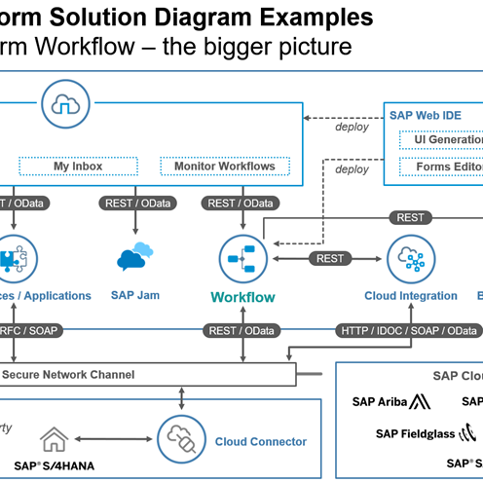
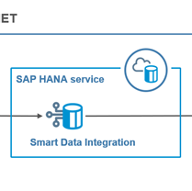
SAP Cloud Platform Solution Diagrams & Icons NEW Service Icons, SaaS Application Icons and Diagram Examples
New Version v08 July 5, 2019
Data Privacy & Security
Globalization
Integration
LoBs & Industries
Data Retention Manager
Data Privacy Governance
SAP Localization Hub, advanced compliance reporting service
SAP Localization Hub, candidate pipeline service
SAP Localization Hub, digital compliance service for <country>
Smart Data Integration
SAP Customer Order Sourcing
SAP Omnichannel Promotion Pricing
Data Management
Diagram Examples (SAP Cloud Platform Workflow, Gaining Consumer Insights)
Master Data
Orchestration
Other Icons
SAP Data Intelligence
SAP Intelligent RPA
SDK
Master Data for Business Partners
Pricing service
Product configuration service
SAP S/4HANA Cloud for Data Enrichment
SAP SaaS Application Icons

Slide 93




https://www.sap.com/community/topic/cloud-platform.html
https://cloudplatform.sap.com
http://twitter.com/sapcp
Thank you.
SAP Cloud Platform Solution Diagrams Contacts for Customers & Partners
Bertram Ganz, SAP Cloud Platform PM & Operations (Central PM), SAP SE
bertram.ganz@sap.com
@BeGanz

